Slide 1
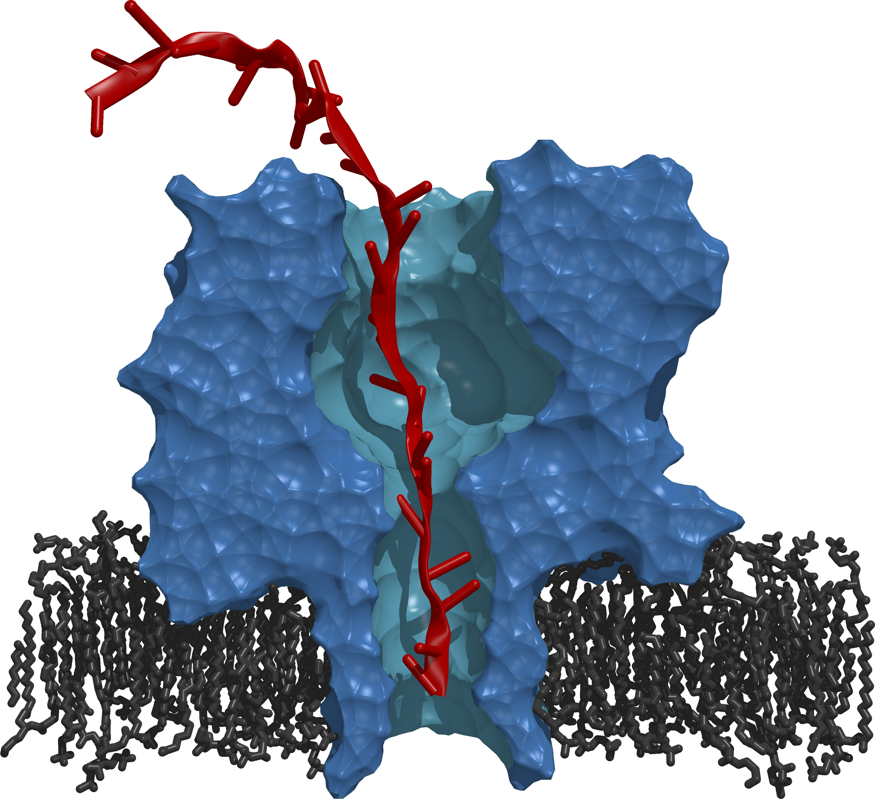

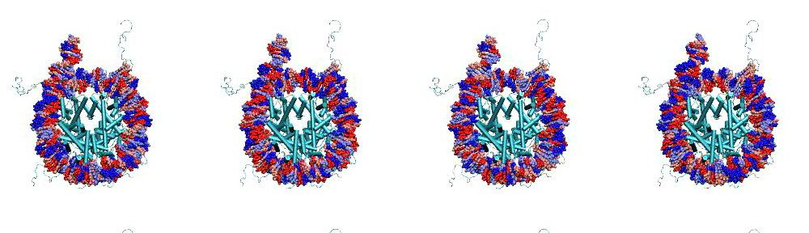
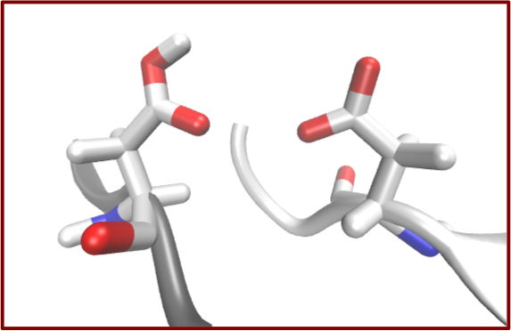
Antons Treikalis, Ole Weidner, SJ
http://radical.rutgers.edu

Slide 2
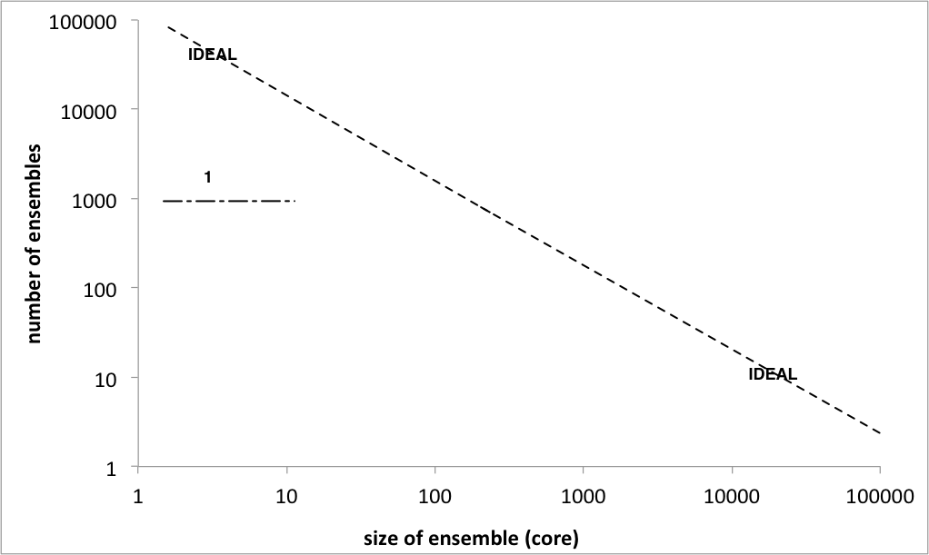
“Many Simulations” Pathway to Extreme Scale
Problems in computational science naturally amenable to “many simulations” model of computing:
Many free energy calculations, enhanced sampling problems.
Many multi-physics simulations are also multi components.
Single “application” might be broken into many smaller simulations
This is not just HTC or HPC, but complex application objectives
Isn’t about just peak perf, nor maximal throughput
Given access to X cores/nodes – slice/dice or distribute as needed
Notes:
PF = PetaFlops
Free-energy = measure of the degree of dynamism of a physical system.
Enhance sampling = we cannot sample every state, we use algorithms to reduce the number of sampled states, still effective because of ergodic hypothesis.
Simulation:
Homogeneous/heterogeneous = the same physical system simulated with different parameters / different physical systems
Coordination = Temporal and special ordering (leads to different models of communication?)
Dependences = Temporal among simulations.
Varying across these axes you can generate almost any workflow.
Bag of tasks is the center.

Slide 3
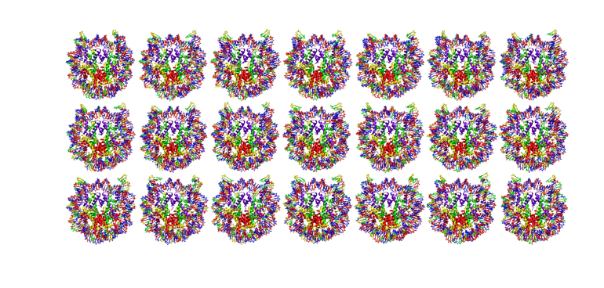
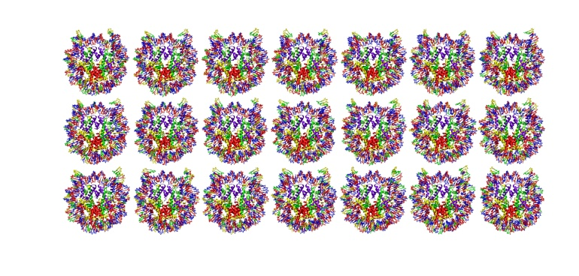
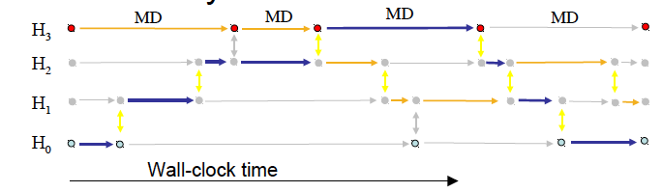
Scalable Online Comparative Genomics of Mononucleosomes.
“Scalable Online Comparative Genomics of Mononucleosomes: A BigJob” , Proceedings of Conference on XSEDE, 2013.
Asynchronous Replica-Exchange: Advanced Algorithms for enhanced sampling.
“A Framework for Flexible and Scalable Replica-Exchange on Production Distributed CI”, Proceedings of Conference on XSEDE, 2013.
Notes:
Set up the problem of synchronizing many tasks! Get histogram
Many simulation
A simulation is a single MPI job
They are all MPI – 128 – 512 cores for each simulation
Problem 1: determine the binding and position of the mononucleosome – Enemble:
210 combinations, 20 nanoseconds, repeats 10 times to get 20 nanoseconds, 2100 simulations for 1 particular study (candidate). The problem is not reducible and hits the limits of computational availability (e.g. cluster available with queues of 24h)
240 cores/hour, 3.5GB output per 1ns simulation.
Group of tasks have temporal dependencies but the tasks themselves are independent (bag of tasks)
Problem 2: Molecular simulation – Replica exchange:
Running multiple replicas at the same time (anything from few to hundreds of thousands, the more the merrier because better approximation to the problem)
Tasks needs to synchronize by means of communication. Different algorithms to do that, pairing pre-defined => regular replica exchange. Replicas are exchanging anyway. Pairing and time of exchange can be fixed (regular) or dynamic (irregular).
For both cases: the more the better for the science.
The class of scientific problems that is amenable to ‘Many Simulations’ approach is called: free energy.

Slide 4
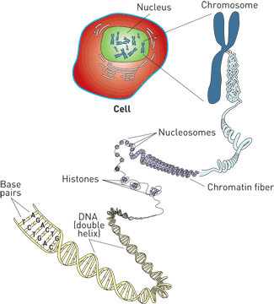
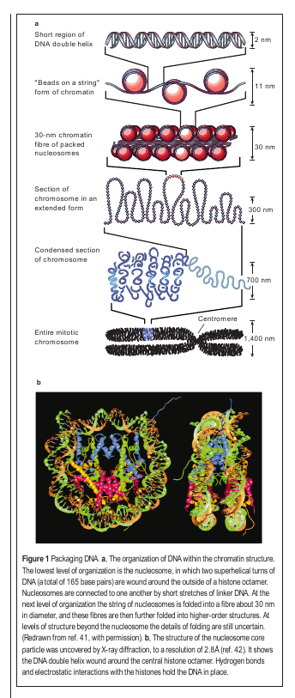
Setting the Scale
A Typical “Run”
210 Simulations (5 x 21 x 2)
2400 Cores on Lonestar for ~21 hrs
~50,000 SUs
~750 GB of output
Total:
10+ Runs (2100 simulations)
4 Restarts
~500,000+ SUs
~7.5 TB of output
Felsenfeld&Groudine,
Nature Jan 2003

Slide 5
From Many Simulations to Complex Applications
Starting from uncoupled heterogeneous simulations, varying levels of coordination and dependency can be gradually added and “tuned”
Homogeneous/Heterogeneous
Complexity of simulation-resources mapping
Coupling between simulations
Different coordination mechanism
Dependencies
Constraints, scheduling, data transfer
D
C
H
Depending upon the above properties, the importance and feasibility of distribution varies
Notes:
PF = PetaFlops
Free-energy = measure of the degree of dynamism of a physical system.
Enhance sampling = we cannot sample every state, we use algorithms to reduce the number of sampled states, still effective because of ergodic hypothesis.
Simulation:
Homogeneous/heterogeneous = the same physical system simulated with different parameters / different physical systems
Coordination = Temporal and special ordering (leads to different models of communication?)
Dependences = Temporal among simulations.
Varying across these axes you can generate almost any workflow.
Bag of tasks is the center.

Slide 6
Why Distributed Extreme Scale Computing?
Support new science and new usage modes
Different modes of extreme-scale computing
Coupling X-flops of computing with X-bytes of data
Large-scale simulations integrated with distributed big-data analysis (ATLAS, HEP)
Real-time computing coupled with distributed data from scientific experiments (LSST, SKA)
Support the “long tail of science”
New execution modes for efficient and effective utilization of collective set of resources
Offload workloads from leadership to less powerful machines
Onload workloads from distributed systems onto leadership
Strategically and synergistically, not competitively
Notes:
MORE THAN HPC/HTC
Nuanced view of Resources and application types!

Slide 7

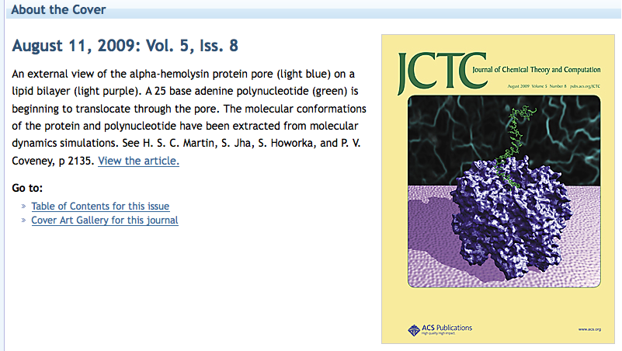
A Pore Man’s View of the TeraGrid/XSEDE
2005-09: Tried running many simulations on many supercomputers. Did not work (well)!
Why? What has changed?
Notes:
We are not speaking about a trivial problem! Formulating a problem in terms of many-simulations (partially) failed already at petascale:
A lot of the time has been spent in formulating the problem in terms of many simulations.
Marshaling/managing/efficient mapping happened at order 10, barely made order 100, broke down at order 1000 (of large simulations)
This problem highlights some of the challenges in running many simulations on many supercomputers
Things are not working. I contend that if we took a more systems approach to building our infrastructure -- viewed as a whole, expose/provide the right abstractions, then it is possible.

Slide 8
Extreme Scale Distributed Computing in 2013
First generation of DC characterized by “gluing it” together
Many local solutions, lack of end-to-end solutions
Inability to reason about spatio-temporal execution properties
Given a general workload there is an inability to estimate how long a workload will take? And where (and why) it will execute?
Complete absence of analytical models of applications, infrastructure
And we do not know how wrong our estimates would be!
We are still learning how to architect large-scale systems
Scaling remains difficult for individual scientists
< 1% can do O(100) tasks of O(10GB) over O(10) nodes
Macroscopic vs microscopic theory of distributed systems!
Missing principles and practice of “systems in the large”

Slide 9
RADICAL Abstractions, Models and Tools

Slide 10
Pilot Abstractions
Working definition: A system that generalizes a placeholder job to provide multi-level scheduling to allow application-level control over the system scheduler via a scheduling overlay.
User Space
User Application
Pilot-Job System
Policies
Pilot-Job
Pilot-Job
Resource Manager
System Space
Resource A
Resource B
Resource C
Resource D

Slide 11
Introduction to Pilot-Abstraction (2)
Working definitions:
A system that generalizes a placeholder job to provide multi-level scheduling to allow application-level control over the system scheduler via a scheduling overlay
“.. defined as an abstraction that generalizes the reoccurring concept of utilizing a placeholder job as a container for a set of compute tasks; an instance of that placeholder job is referred to as Pilot-Job or pilot.”
Advantages of Pilot-Abstractions:
The Perfect Pilot: Decouples workload from resource management
Flexible Resource Management
Enables the fine-grained (ie “slicing and dicing”) of resources
Tighter temporal control and other advantages of application-level Scheduling (avoid limitations of system-level only scheduling)
Move control, extensibility and flexibility “upwards”
Build higher-level capabilities without explicit resource management
Notes:
Pilot-jobs as a (A)RM because of limitations of the middleware and infrastructure. Different middleware; differenent limitations. Therefore different pilot jobs semantically and functionally.
Pilots tell you what to do (N x M) but not why or how?

Slide 12
Landscape of Pilot-Job Systems
There are many PJS offerings, often semantically distinct
PanDA, DIANE, DIRAC, Condor Glide-In, SWIFT, ToPoS Falkon, BigJob…
Why do you think there has been a proliferation of PJs?
Conceptual & practical barriers to extensibility (& interoperability)
The landscape of PJS reflects, in addition to PJS specifics, the broader eco-system of distributed middleware & infrastructure
Software Engineering issues, interfaces, standardization
Difference in the execution models of the PJ
We know “what” pilot-jobs do, but the “how” remains less clear
How to map tasks to pilot-jobs? How to choose/map optimal resource?
How to “slice and dice” resources?
Data remains a dependent variable, not a primary variable
Introduce the concept of Pilot-data
Notes:
Pilot-jobs as a (A)RM because of limitations of the middleware and infrastructure. Different middleware; differenent limitations. Therefore different pilot jobs semantically and functionally.
Pilots tell you what to do (N x M) but not why or how?

Slide 13
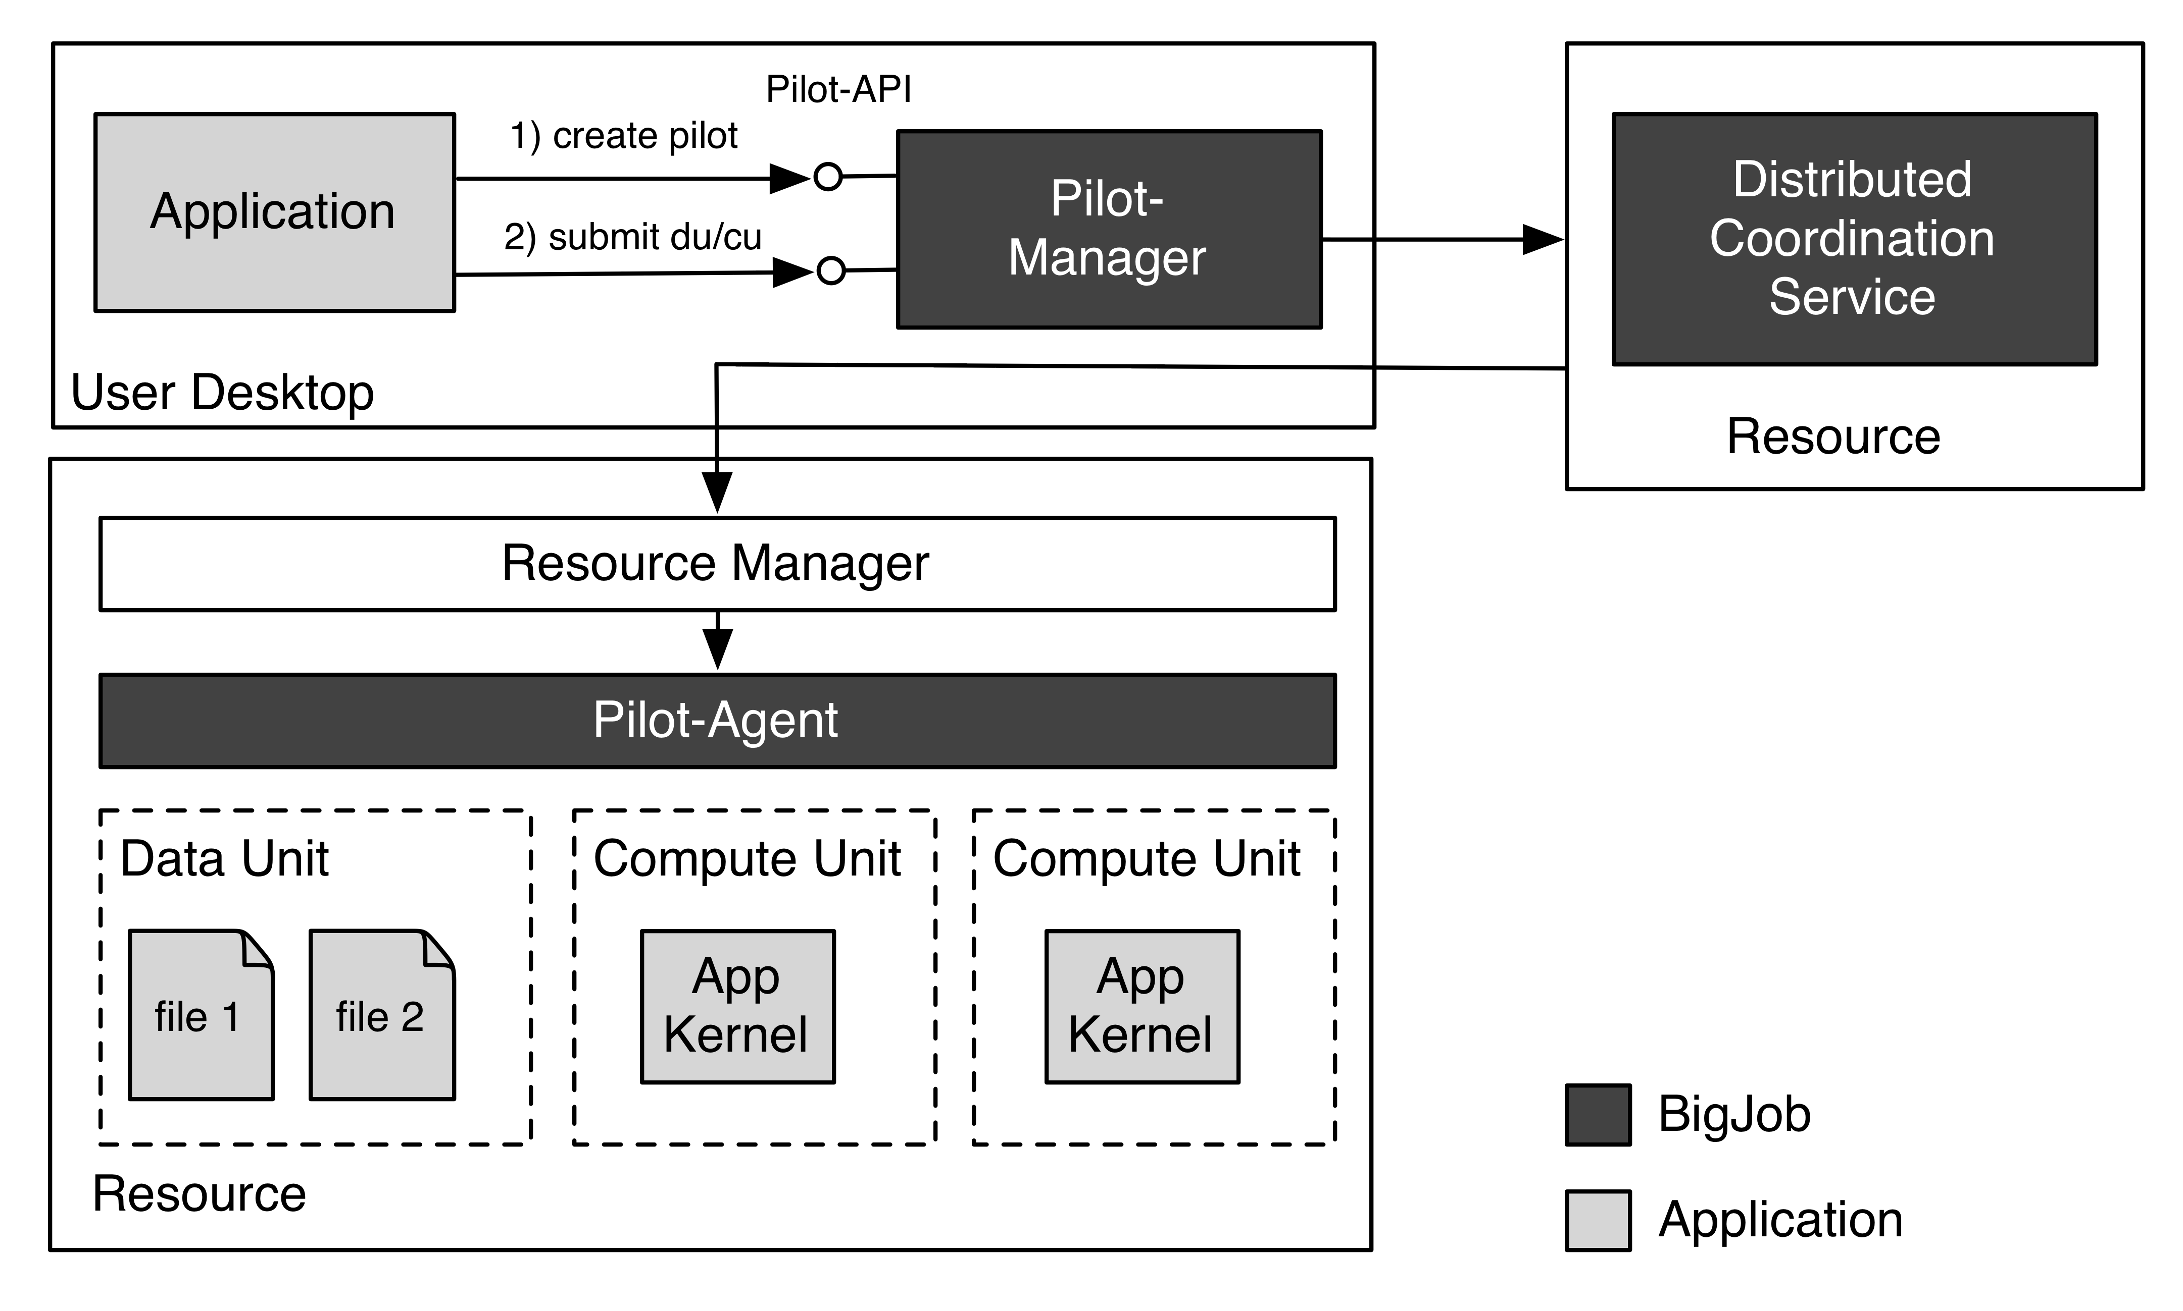
BigJob: Architecture

Slide 14
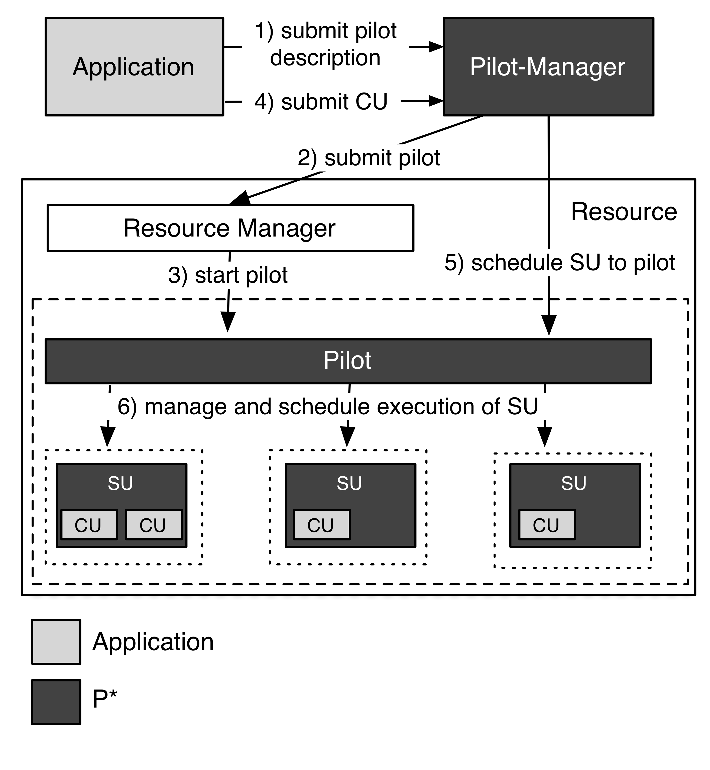
P* Model: Elements, Characteristics and API
Elements:
Pilot-Compute (PC).
Pilot-Data (PD).
Compute Unit (CU).
Data Unit (DU).
Scheduling Unit (SU).
Pilot-Manager (PM).
Characteristics:
Coordination.
Communication.
Scheduling.
Pilot-API.
“P*: A Model of Pilot-Abstractions”, 8th IEEE International Conference on e-Science 2012, 2012

Slide 15
“Coarse-Grained” BigJob Performance
Number of zero-payload tasks that BJ can dispatch per second:
Distributed: O(1)
Locally: > O(10)
Number of Pilots (Pilot-Agents) that can be marshaled
Locally/Distributed: O(100)
Typical number of tasks per Pilot-Agent:
Locally/distributed: O(1000)
Number of tasks concurrently managed = Number of Pilot-Agents x tasks per each agent :
O(100) x O(1000)
(Obviously) The above depends upon data per task:
BigJob has been used over O(1)--O(10⁹) bytes/task, for tasks of duration O(1) second to O(10⁵) seconds

Slide 16
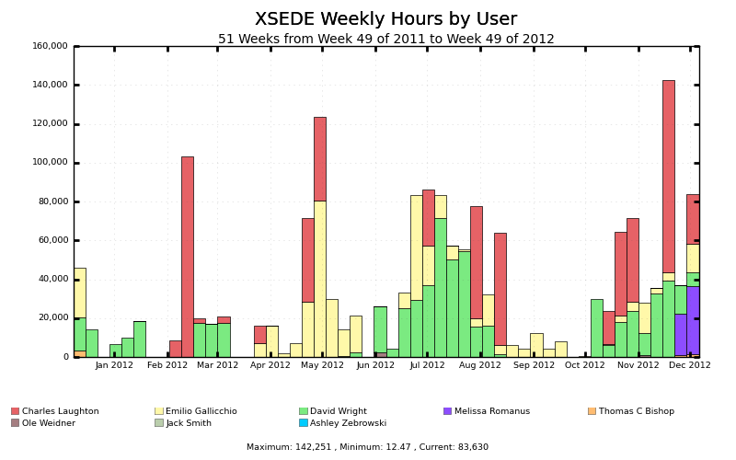
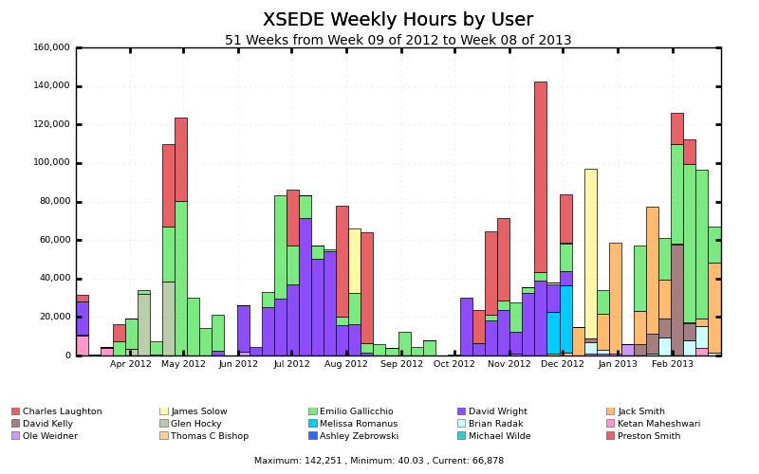
BigJob: (Partial) Usage on XSEDE Machines
> 10M SUs/year (and increasing) on XSEDE machines

Slide 17
saga-python
A Light-Weight Access Layer for Distributed Computing Infrastructure

Slide 18
SAGA: Interoperability Layer for BigJob
SAGA – Simple API for Distributed (“Grid”) Applications:
Application level standardized (Open Grid Forum GFD.90) API.
Application is a broad term: “one person’s application is another person’s tool (building block)”.
SAGA-Python:
Native Python implementation of Open Grid Forum GFD.90.
Allows access to different middleware / services through a unified interface
Provides access via different backend plug-ins (“adaptors”).
SAGA-Python provides both a common API, but also unified semantics across heterogeneous middleware:
Transparent Remote operations (SSH / GSISSH tunneling).
Asynchronous operations.
Callbacks.
Error Handling.

Slide 19
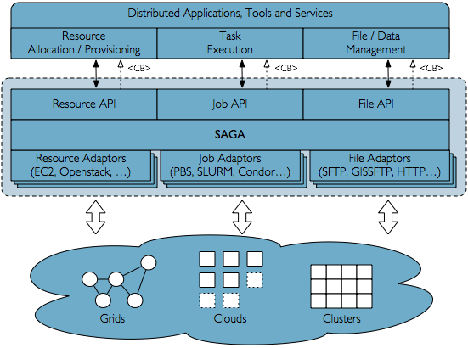
SAGA Schematic

Slide 20
Unified Semantics
saga-python provides not only a common API, but also unified semantics across heterogeneous middleware:
Transparent Remote operations (SSH / GSISSH tunneling)
Asynchronous operations
Callbacks
Error Handling

Slide 21
Supported Middleware and Services
Job Submission Systems
SSH, GSISSH, Condor, Condor-G, PBS(-Pro), TORQUE, SGE, SLURM
File / Data Management
SFTP, GSIFTP, HTTP, HTTPS, (iRODS under development)
Resource Management / Clouds
Amazon EC2 (‘libcloud’-based)

Slide 22
Insert new slides for SAGA-Python updates used for PANDA

Slide 23
SAGA-Pilot
Lightweight, portable, fast, scalable pilot framework next generation BigJob
Focuses on enabling CS research
But might just be able to support some “production” users
Focuses on pilot jobs, but will enable research on pilot data
Scalability (up and out)
Lightweight data model
Bulk operations
Notifications / support for async programming
Portability
Pure Python
Modular pilot agent
SAGA-Python as plumbing layer
Supports Research
Pluggable schedulers
High degree of introspection, provenance
Consistent and verifiable performance

Slide 24
SAGA-Pilot
Status:
Release candidate in 12/2013
Fit for research in Q1/2014
Already significantly faster than BigJob, while maintaining portability
Users:
Mostly in-group, e.g. AIMES, ExTASY etc
Research on infrastructure modeling and federation
Research on multi-level scheduling, affinities
Tiered of Resource OverlaY (TROY)

Slide 25
References
SAGA-Python:
http://saga-project.github.io/saga-python/
BigJob: An implementation of P*
http://saga-project.github.io/BigJob/
SAGA-Project:
http://saga-project.org
SAGA-Pilot:
Coming Soon
TROY:
Coming Soon

